Slide 1
Writing a HOWTO Guide for DDI
An approach for getting started

Slide 2
Background
Dagstuhl Longitudinal Workshop
Three Groups
Generic Process Model for Longitudinal Studies (up next)
Foundational Metadata
How to get Started with DDI (this one)

Slide 3
Approach
Different levels of experience in the group
Brainstormed how different ways people new to DDI may approach
Fitting existing metadata into DDI
Mapping existing database to DDI
Planning how to integrate DDI into a new project
Inserting DDI into an ongoing project
Technical vs. content focus
Notes:
Our group had varying levels of experience with DDI:
- people who have been around from the beginning
- ~1 year of experience
- Brand new

Slide 4
What does “using DDI” mean?
Produce DDI that validates against the DDI schema
Study instance
Resource packages
Goal: make this easier for people who are new to DDI
Provide starting points
Check list of questions or issues to consider
Notes:
At a basic level, using DDI means that you are able to produce an XML file that validates against the DDI XML schema.
This goal paper is to show how to do that.

Slide 5
Audience
Technical
XML Authors
Developer/Programmers
End Users
Metadata Authors
Researchers

Slide 6
Structure of Longitudinal Study
Background, Foundational Information
Reusable Elements
Concepts, Code lists, Questions
Data Processing
Variable Development
Dataset Documentation

Slide 7
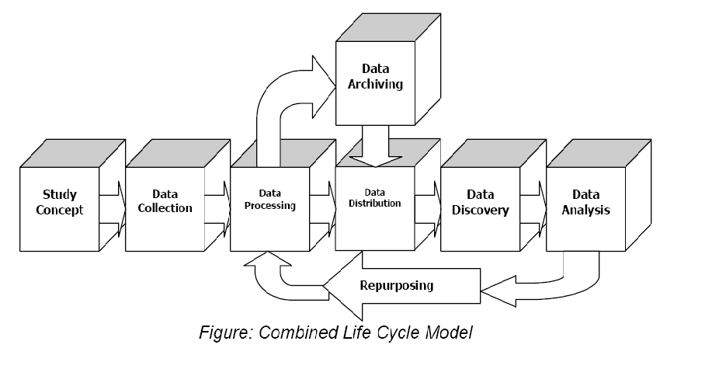
DDI 3 Lifecycle Model
Metadata Reuse
Notes:
7
The structure of a longitudinal study fits well with the DDI lifecycle model.
It’s just that some of the parts are repeated.

Slide 8
You are Here: Different Entry Points
New study
Without existing materials
With existing materials
New round of data collection
Mid-cycle of a longitudinal study
After study completion
Documentation only (the process is over)

Slide 9
Results
Paper will walk through a sample study
Different check lists for each entry point
Annotated DDI examples
Coming soon…

Slide 10
Thank you
Wendy Thomas (wlt@umn.edu)
Coauthors
Joan Corbett
Jeremy Iverson
Sophia Kuan
Abdul Rahim

